Slide 1
Pls 2000 power & politics dr. shannon
LAW & THE RULE OF LAW

Slide 2
COURTS & LAW
I. JUDICIAL POWER
II. RIGHTS REVISITED
III. COURT CASES
TERMS TO KNOW
Bill of Rights Plessy v. Ferguson (1896)
Rule of 4 Brown v. Board of Education (1954)
Majority, concurring and dissenting opinion Checks and Balances
Miranda Rights Shadow Docket
Citizens United DC v. Heller
Roe v. Wade The Supremes

Slide 3
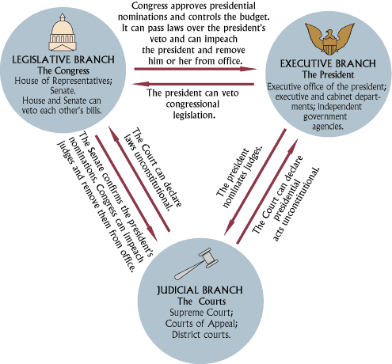
i. Judicial power
Separate offices & functions?
Legislative
Executive
Judicial
Checks and Balances
Judicial Review: Rules on the constitutionality of executive and legislative decisions
https://www.lawyersnjurists.com/article/separation-of-power-and-uk-constitution/
https://sites.google.com/site/comparativegovernmentrussia/activities
http://www1.curriculum.edu.au/ddunits/guide/g5b_chart.htm

Slide 4
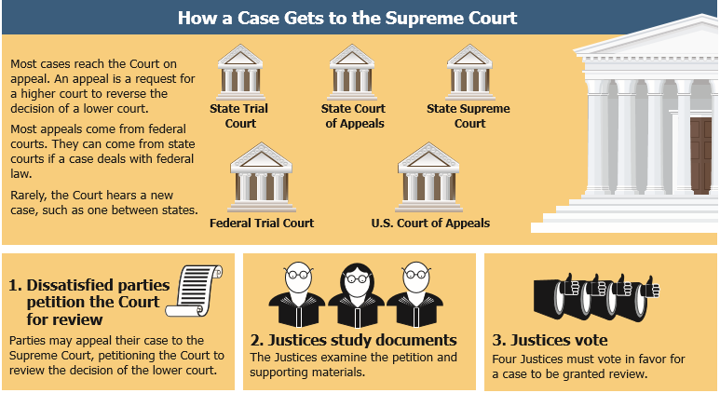
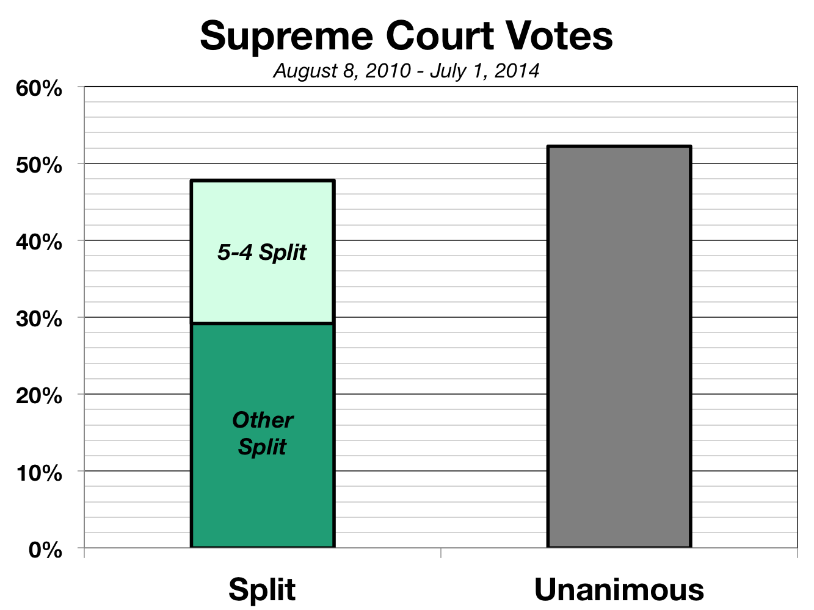
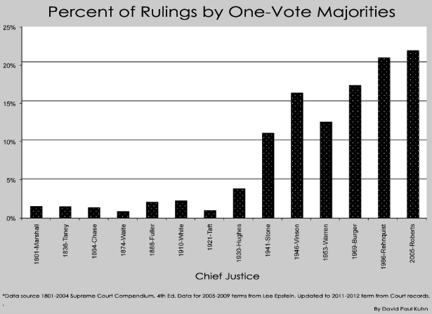
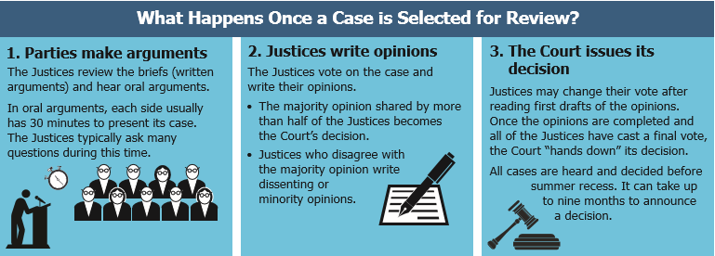
The supreme court
Entertains appeals from lower federal courts or state courts addressing federal law
“Writ of Cert” & the Rule of 4
Decisions
Originalism (Strict Constructionists) vs. “Living, Breathing Document”
Precedent
Reasonableness
Ideology (“activist court”)
Rulings
Majority Opinion: decision and ruling on the case
Concurring Opinion: votes with the majority but for different reasons
Dissenting Opinion: the minority position opposed to the ruling
https://kids.usa.gov/government/supreme-court/index.shtml
http://www.theatlantic.com/politics/archive/2012/06/the-incredible-polarization-and-politicization-of-the-supreme-court/259155/

Slide 5
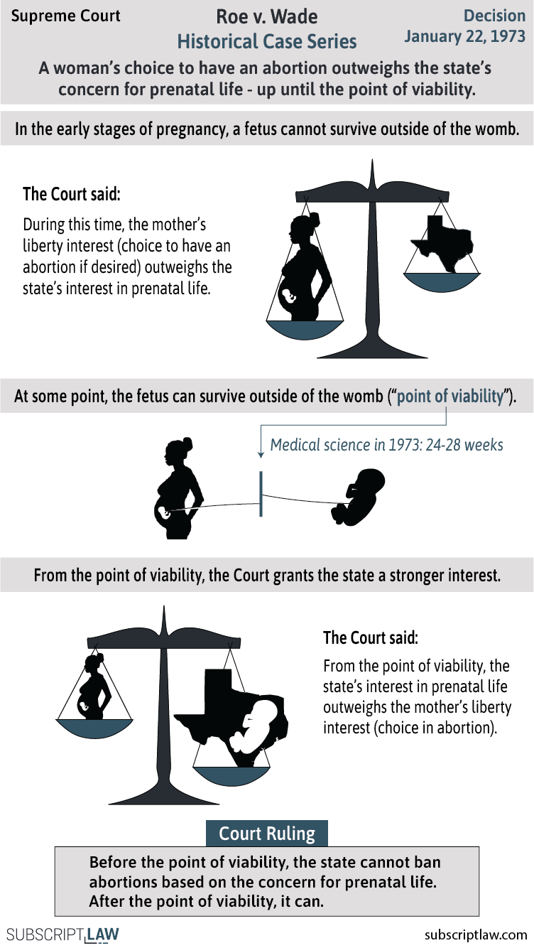
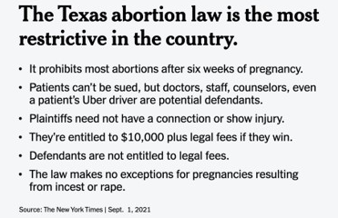
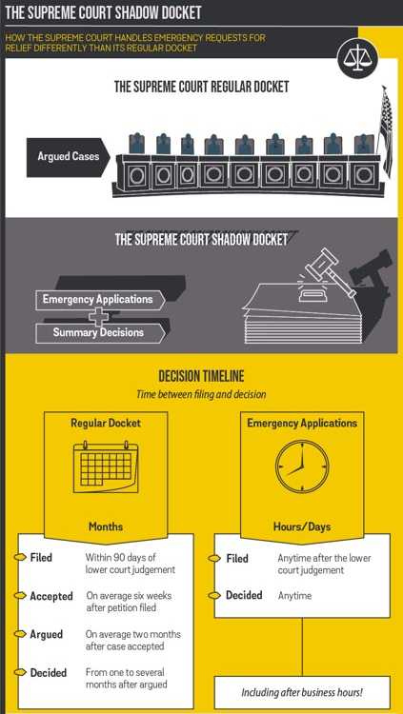
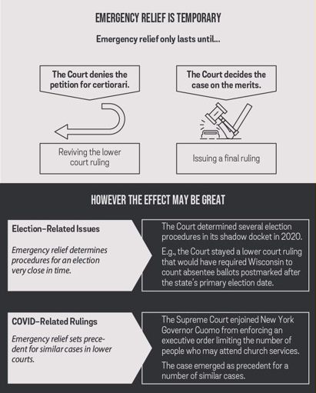
Abortion and the shadow docket
Roe v. Wade (1973)
2021 Texas Law
Court Challenge and the Shadow Docket
5-4 Vote: the abortion providers who had challenged the law in an emergency application to the court had not made their case in the face of “complex and novel” procedural questions.
was not ruling on the constitutionality of the law and not limiting any and all “procedurally proper challenges” to it
https://www.statista.com/chart/18048/american-women-support-of-roe-vs-wade/
https://subscriptlaw.com/supreme-court-shadow-docket/
https://www.nytimes.com/2021/09/01/us/supreme-court-texas-abortion.html
https://subscriptlaw.com/roe-v-wade/
Notes:
Shadow docket: emergency hearing of a case

Slide 6
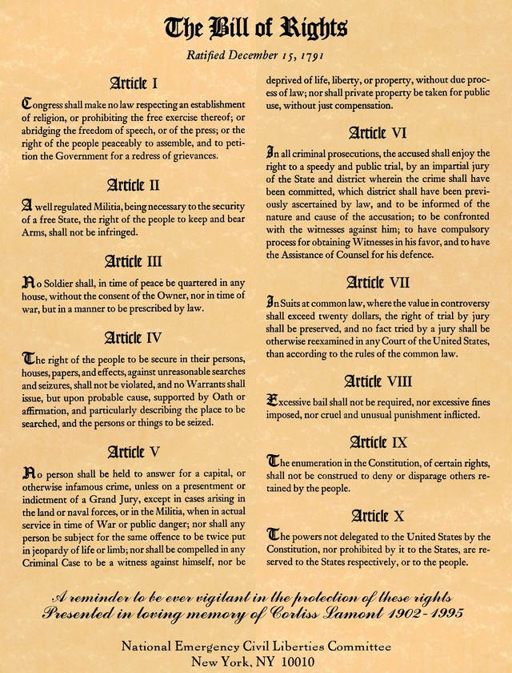
II. Rights revisited
AMENDMENTS 1-10: THE BILL OF RIGHTS
1ST AMENDMENT: Religion, Speech, Press, Assembly, & Petition Government
2ND AMENDMENT
4TH AMENDMENT: warrants, probably cause, and No unreasonable search & seizure
5TH AMENDMENT: Due Process & No self-incrimination
6TH AMENDMENT: Speedy, Public Trial by Impartial Jury of Peers, with a right to attorney

Slide 7
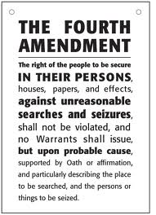
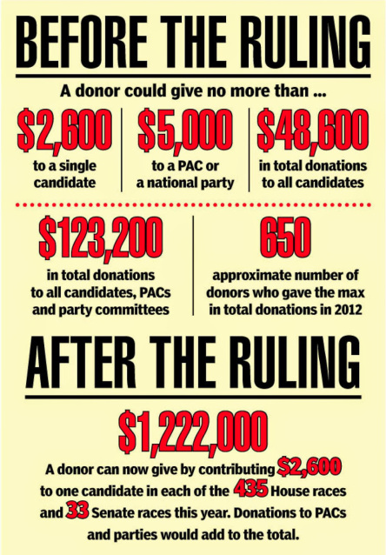
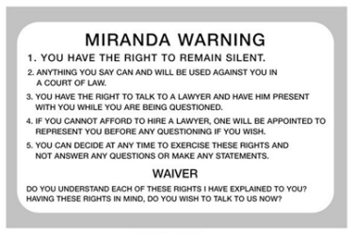
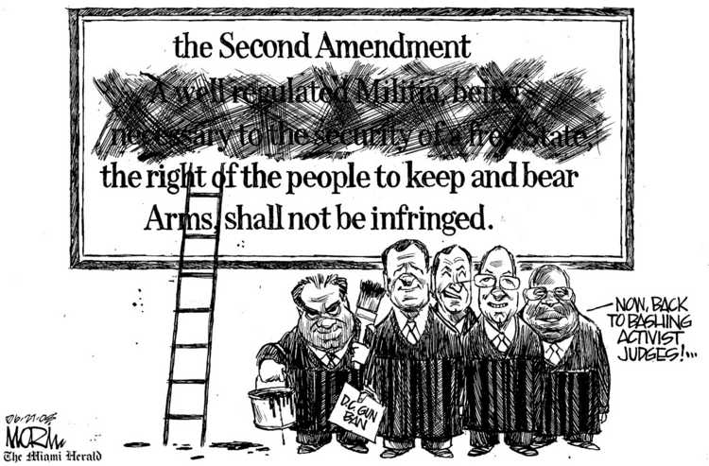
COURT CASES
Case | Ruling | Amendment
Mapp v. Ohio (1961) | Exclusionary rule: evidence from an illegal search cannot be used in a court of law | 4th
Miranda v. Arizona (1966) | Defendant confessed but was never alerted to constitutional rights prior to interrogation (Miranda Rights) | 5th, 6th
Citizens United v. FEC (2010) | “Government may no more restrict how many candidates or causes a donor may support than it may tell a newspaper how many candidates it may endorse” | 1st
D.C. v. Heller (2008) | Individual right to possess a firearm is unconnected with service in a militia | 2nd
https://rationalhumor.com/tag/citizens-united/

